Slide 1

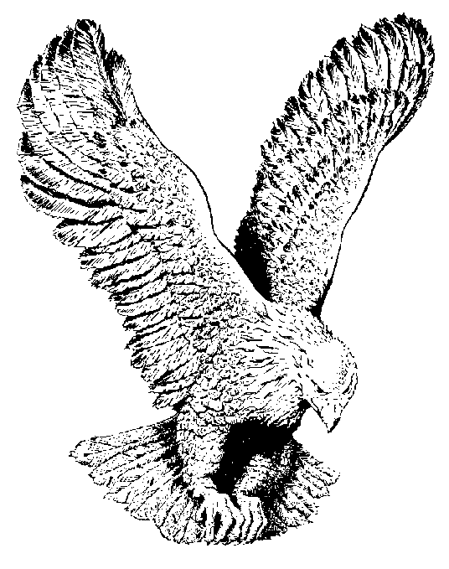
767 MY SAVIOUR CRUCIFIED
And this is why I love Him.
Because He first loved me.
To purchase my redemption
He hung upon the tree.
At last He cried “Tis finished”
He hung His head and died,
O what a sight for sinners,
My Saviour crucified.

